Slide 1

Fundamentals of Data Science
“Decision Tree”
Trainer: Ulviyya Jafarli
Notes:
1

Slide 2
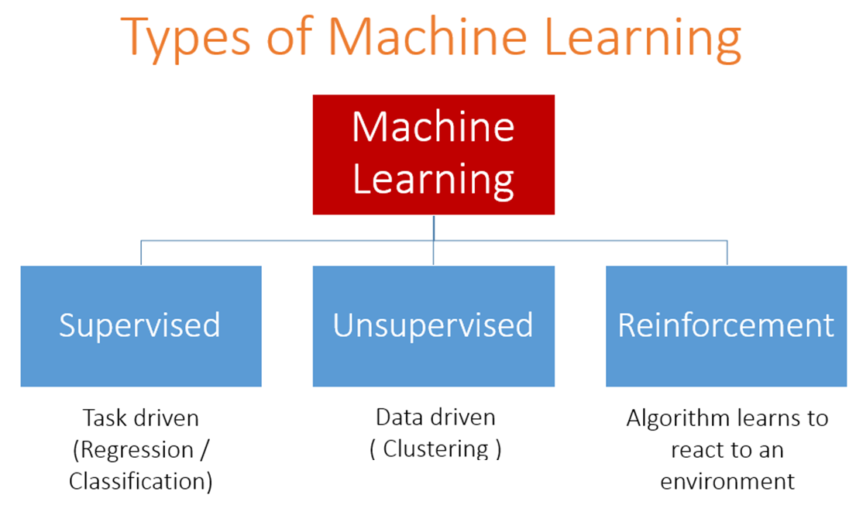
© 2020. “G&I Academy of Business” LLC
2
An acquaintance of “Data science”
|
Notes:
2

Slide 3
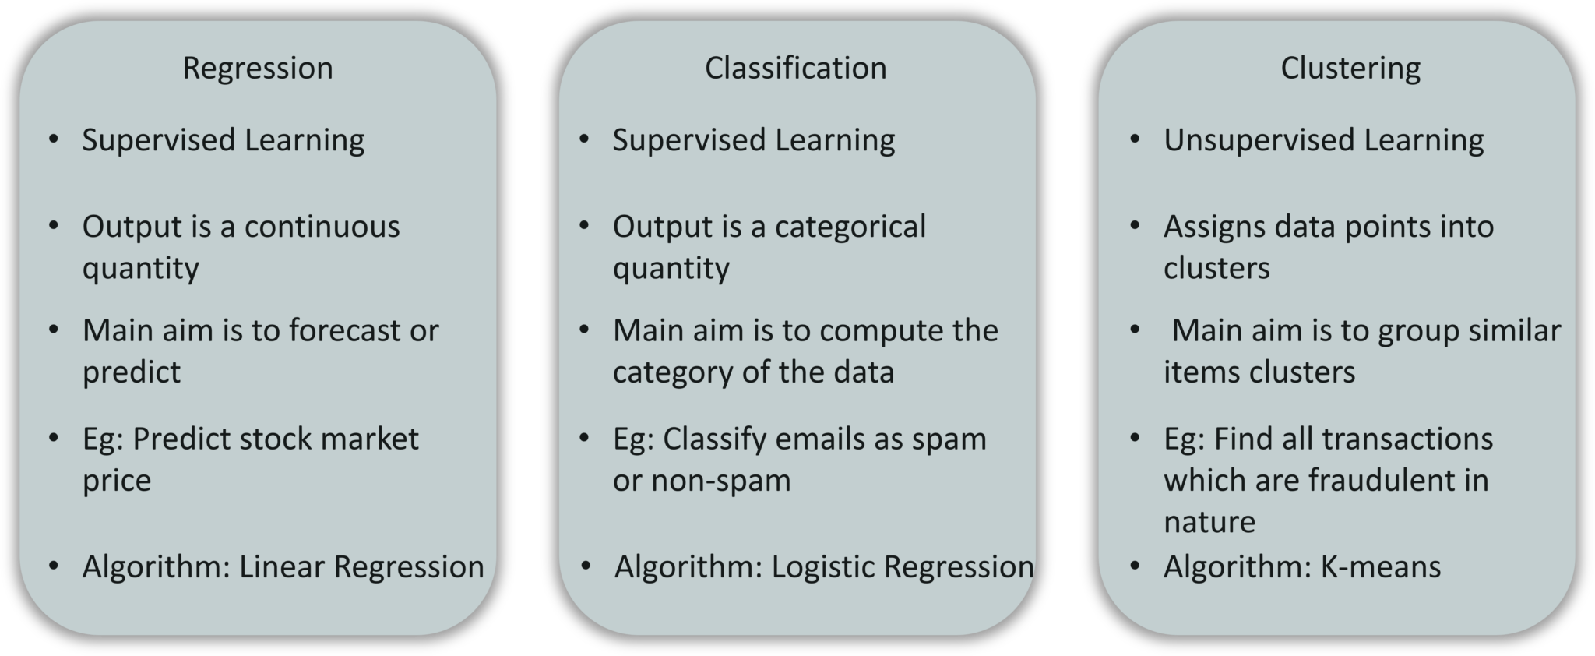
© 2020. “G&I Academy of Business” LLC
3
An acquaintance of “Data science”
|
Notes:
3

Slide 4
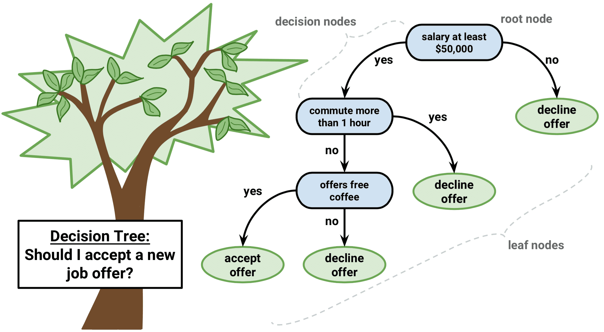
Decision Tree
© 2020. “G&I Academy of Business” LLC
4
An acquaintance of “Data science”
|
Notes:
4

Slide 5
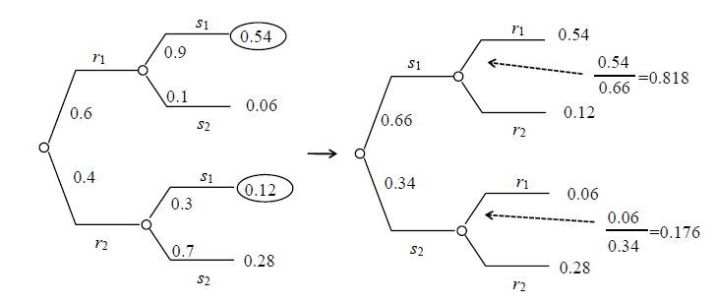
Decision Tree in Probability
© 2020. “G&I Academy of Business” LLC
5
An acquaintance of “Data science”
|
Notes:
5

Slide 6
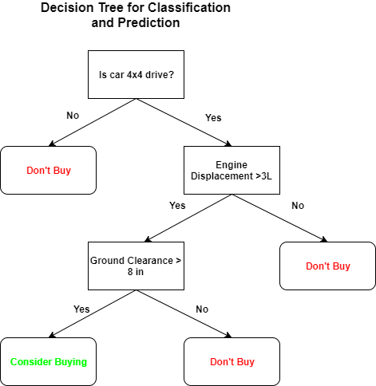
Decision Tree Algorithm
© 2020. “G&I Academy of Business” LLC
6
An acquaintance of “Data science”
|
Notes:
6

Slide 7
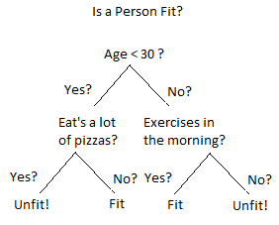
Decision Tree in Classification
© 2020. “G&I Academy of Business” LLC
7
An acquaintance of “Data science”
|
Notes:
7

Slide 8
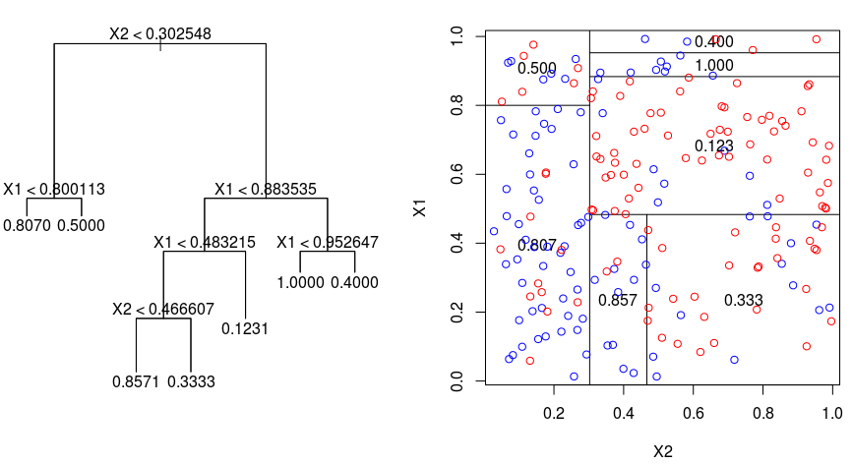
Decision Tree in Regression
© 2020. “G&I Academy of Business” LLC
8
An acquaintance of “Data science”
|
Notes:
8

Slide 9
Thank you for your attention!
17
© 2020. “G&I Academy of Business” LLC
|
Notes:
ou
9

